Slide 1
TECH TALK
TECH TALK – FAMILY NIGHT
01.

Slide 2
Welcome Parents!
TECH TALK – FAMILY NIGHT
Goals for tonight:
To help you understand how your children are using the Internet and personal technology (trends, apps, websites, etc.)
To get to know the 4 pillars: Be Online, Be Safe, Be Kind, Be Smart
To empower yourself (and in turn, your kids) to be mindful and responsible Internet users
To help you stay up to date with new information and apps
Guest Speaker Technology Expert will be answering questions and giving recommendations.
To have meaningful and ongoing conversations about Internet safety and technology with friends, family members, neighbors, and teachers
01.

Slide 3
What Do You Know?
TECH TALK – FAMILY NIGHT
How much do you know about kids’ Internet lives and what they do online?
What Apps they are constantly on?
How much time they spend online?
Do you check their iPad/phone often?
Do you restrict certain apps or websites?
What do You know?
Are your kids safe online?
01.

Slide 4
01.
28% of 2-year-olds can navigate a mobile device with no help
21% of 4-year-olds own a gaming console
85% of parents allow their children ages 6 and younger to use technology at home
Popular apps: Minecraft, YouTube for Kids, Roblox, TikTok, Fortnite, houseparty, GoogleDuo (often with older siblings)
What Are Younger Kids Up To?

Slide 5
95% of teens report going online daily; 45% of those go online “almost constantly” (almost double since 2014-17)
You might have heard of Fortnite....Overall, 84% of teens have or have access to a gaming console, and 90% play some form of video game (console, smartphone, computer)
Facebook no longer dominant social media platform for teens; now gravitate toward YouTube, Instagram, Snapchat, Houseparty
Other sites and apps of choice include Twitter, Roblox, TikTok
TECH TALK – FAMILY NIGHT
What Are Kids, Tweens and Teens Up To?
Sites and apps being used change quickly
http://internetsafety.trendmicro.com
http://cyberbullying.org/blog
www.gaggle.net/top-social-networking-sites-and-apps-kids-use
Kids under the age of 14 should not have access to the internet and apps that are for 18+ ages.
01.

Slide 6
THE FOUR PILLARS OF GOOD INTERNET SAFETY
BE ONLINE
BE KIND
Have fun, learn, and make social connections
Understand and respect safety, ethics, and privacy
Maintain balance with online and real-life activities
Promote a positive experience
Remind your child not to post (or participate in) messages or photos that criticize or make fun of others—especially cyberbullying
If you find out your child has been unkind online, take steps to address it
Be kind online—including to yourself!
Let your child see you modeling kind online behaviors, to others and to yourself
1
2
4
3
BE SAFE
BE SMART
Protect personal information
Use security software
Be mindful of potential for people with bad or unkind intentions.
Manage apps, devices, and toys that use geolocation
Create good habits
Balance the amount of time spent online vs. with real-life activities
Respect others’ offline time
Be familiar with the ways your own posts can be used and misused
Encourage kids to be “first responders” (#Icanhelp)
Protect your child’s digital footprint https://www.safety.com/child-digital-footprint/

Slide 7
Be Online Together
Create a Family Digital Code of Conduct
Help Manage Their Digital Footprint
Keep the Conversation Going
WHAT’S NEXT?
Be Online Together
Decide the basics
Set the rules
Teach them to be good digital citizens
Model good digital/online behavior
Respect their privacy
Let them try
Keep the conversation going
Share your own experiences
Be online with them
01.

Slide 8
Be Online Together
Create a Family Digital Code of Conduct
Help Manage Their Digital Footprint
Keep the Conversation Going
WHAT’S NEXT?
Create a Family Digital Code of Conduct
Protect your personal information.
Treat others online as you would treat them in person.
Be kind to yourself.
Balance your real and online lives and be respectful of others’ offline time.
Avoid plagiarism and copyright infringement.
Tell your parents if something you see online makes you uncomfortable or worries you, or if a stranger tries to contact you.
Check with your parents before downloading anything or connecting with anyone new.
01.

Slide 9
Be Online Together
Create a Family Digital Code of Conduct
Help Manage Their Digital Footprint
Keep the Conversation Going
WHAT’S NEXT?
Help Manage Their Digital Footprint
Use strong privacy settings on all social media accounts
Don’t overshare. Resist the temptation to share deeply personal information—that’s what real-life friends are for.
Be wary of information (contests, etc.) you submit online.
Occasionally Google yourself to see what’s out there about you.
Remember—once you share something, it’s always out there.
01.

Slide 10
Be Online Together
Create a Family Digital Code of Conduct
Help Manage Their Digital Footprint
Keep the Conversation Going
WHAT’S NEXT?
Keep the Conversation Going
Ask your child’s teacher whether she talks to the class about being good digital citizens
Talk to the parents of your kids’ friends about keeping a collective eye on (and communicating about) the kids’ Internet activities
Remind your children about letting an adult know if they witness unkind behavior
Educate other adults in your child’s life (relatives, activity leaders, etc.) about the 4 pillars: be online, be safe, be kind, be smart
Watch for monthly email from parent group (with trends, tips, news stories, and more)
01.

Slide 11
GUEST SPEAKER
Jhusara Angulo
Experienced Safety and Risk Manager – Skilled in Emergency Management, Safety Management Systems, Hazard Analysis.
COVERING:
At what age should your child get a phone.
Dangerous APPs your child should not have on their device.
Internet safety tips.
Learn about the YAPPY.
Questions and answers
01.

Slide 12
CELL PHONE AND SMARTPHONE
At what age should my child have a cell phone or smartphone?
There is no magic age when every child should have a cell phone. That’s a decision that depends on the child and the parents, and it’s an expensive one. To help you determine whether your child is ready for a cell phone (and just as important, whether you’re ready for your child to have a cell phone), ask yourself the following questions:
Why does my child want a phone?
Does my child need a cell phone to reach me?
Will my child use the phone responsibly?
Can I handle the constant phone checking?
01.
Recent video BY JESSE WEINBERGER : “When Is My Child Ready for a Smartphone?”
http://www.youtube.com/watch?v=b_z94uFHd6I

Slide 13
TECH TALK – FAMILY NIGHT
01.
“When Is My Child Ready for a Smartphone?”
https://www.youtube.com/watch?v=b_z94uFHd6I

Slide 14
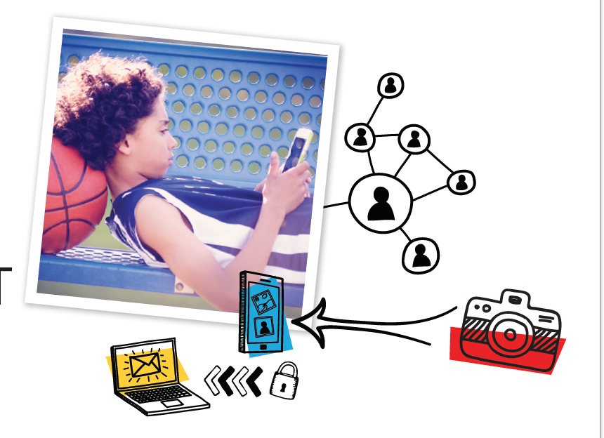
01.
What kind of features does my child need in a phone?
As the parent and protector you should always check what apps are age appropriate and block the ones that are not for their age.
This depends on your child’s age and maturity level and your own comfort level.
What rules should I set for cell phone use?
Respect others
Respect yourself
Keep your phone safe
Turn cell phone off at school, dinner table, and at night.
Cell phone must be charging outside of their room.

Slide 15
APPS EVERY PARENTS SHOULD KNOW ABOUT IN 2020.
a video chatting app – open to anyone
TECH TALK – FAMILY NIGHT
This 17+ app for sharing secrets
a “micro-blogging” platform 17+
freeware instant messaging and VoIP application
send temporary text messages and media content
shows users short viral videos
Kik is a messaging app
01.

Slide 16
APPS EVERY PARENTS SHOULD KNOW ABOUT IN 2020.
walkie-talkie PTT (push-to-talk) app
TECH TALK – FAMILY NIGHT
This is a virtual world game like SIMS
free online chat website
Bigo is a live streaming app. It is rated for teens 17 +
an online dating application based on geosocial networking
cross-platform messaging and Voice over IP service
Periscope is an American live video streaming app
01.
This is an anonymous messenger app

Slide 17
YOUTUBE
Inappropriate content has been sliced into both all-ages content + Children’s Content
TECH TALK – FAMILY NIGHT
Purpose: YouTube is a place to house and share your videos. You can control privacy settings. It’s also a great resource for educational videos and entertainment.
comments on videos can be extremely inappropriate
“My research has led me into a horrifying world where people create cartoons glorifying dangerous topics and scenarios such self-harm, suicide, sexual exploitation, trafficking, domestic violence, sexual abuse, and gun violence which includes a simulated school shooting.”
also has a known pedophile problem
https://pedimom.com/youtube-kids-inappropriate-videos/
01.

Slide 18
Kids under 13+ should not have access to snapchat
SNAPCHAT
Purpose: Snapchat is an American multimedia messaging app. One of the principal features of Snapchat is that pictures and messages are usually only available for a short time before they become inaccessible to their recipients.
Known for their filters.
TECH TALK – FAMILY NIGHT
New web-based Snap Map allows anyone with a browser to head to the page, zoom in and click on any location around the world to see what people are “snapping” about in that vicinity.
No privacy restriction when using snap Map
01.
also has a known pedophile problem

Slide 19
app is rated 13+ and may be slightly tamer than Tumblr
INSTAGRAM
TECH TALK – FAMILY NIGHT
You will find mature or inappropriate content and comments throughout the app
Purpose: This hugely popular photo-sharing site is owned by Facebook, so you may be more familiar with it than with other photo-sharing apps. Users can add cool filters or create collages of their photos and share them across Facebook and other social media platforms.
It can be really dangerous if a fake account gets created using your kid's name and photos.
01.

Slide 20
Roblox: What parents must know about this dangerous game for kids
TECH TALK – FAMILY NIGHT
ROBLOX
Throughout the online gaming world, wherever games are marketed to children, online predators lurk.
Roblox is an online game where players create Avatars, join virtual worlds, play games and chat to friends. However, Roblox can be dangerous to your child’s online safety. Roblox games are user generated, meaning that the virtual worlds within Roblox are created by the young user fan base.
01.

Slide 21
TECH TALK – FAMILY NIGHT
10 Internet Safety and Technology Use Tips for Parents
01.
1) Don’t ban your child from using technology
2) Take an interest in your child’s online world
3) Remember, you’re in charge
4) Create a family media agreement
5) Help your child learn about privacy – YAPPY
6) Help your child to think critically when they’re online
7) Keep the lines of communication open
8) Strive for balance in your household
9) Be aware of age restrictions
10) Educate yourself

Slide 22
TECH TALK – FAMILY NIGHT
Y A P P Y
01.
YAPPY stands for: Your full name, Address, Phone number, Passwords, Your plans and birthday.
Teach your child to keep personal information private online. YAPPY is a useful acronym to remind children of some of the personal information they should not share on public online spaces (blogs, forums, social media, etc.).

Slide 23
A MUST READ
BY JESSE WEINBERGER
TECH TALK – FAMILY NIGHT
01.
Your single and only chance to protect your children is to become educated.
Our Service One.
Jesse Weinberger is an Internet Safety Expert and owner of OvernightGeek University. www.overnightgeek.com
Since 2003, in addition to consulting with school districts and law enforcement, Jesse has traveled all over the United States presenting to tens of thousands of teachers, parents, and students every year.
Jesse is the author of “The Boogeyman Exists: And He’s in Your Child’s Back Pocket” (2nd ed), a complete guide to keeping your children safe in a 24-7 always-connected digital society.
https://www.amazon.com/Boogeyman-Exists-Your-Childs-Pocket/dp/153948081X

Slide 24
TECH TALK – FAMILY NIGHT
A MUST READ
01.
Internet Safety Safety Tips for Parents:
Digital Parenting & Where to Begin
BY JESSE WEINBERGER
https://www.youtube.com/watch?v=keCNU896mMw&feature=youtu.be

Slide 25
RESOURCES
Trend Micro http://internetsafety.trendmicro.com
Lots of information on Internet safety for families from Trend Micro, the sponsor of this Family Tech Talk Night presentation.
ConnectSafely www.connectsafely.org/guides-3
A growing collection of short, clearly written, free downloadable guidebooks that demystify apps, services, and platforms popular with kids and teens, including Facebook, Instagram, and Snapchat.
Jesse “Big Mama” www.connectsafely.org/guides-3
Internet Safety Speaker expert for Schools, Parents, Teachers, and Organizations. Author of the book The Boogeyman Exists: And He’s In Your Child’s Back Pocket
Common Sense Media www.commonsensemedia.org
Provides reviews and ratings for websites and other media for children according to age-appropriateness.
Cyberbullying Research Center http://cyberbullying.org
Provides up-to-date information about the nature, extent, causes, and consequences of cyberbullying among adolescents.
Gaggle www.gaggle.net
Provides safe online learning products and solutions to the K-12 market; the website also offers regular updates on social networks and apps that are used by children.
National Association for Media Literacy Education Parent Guide https://namle.net/a-parents-guide
A comprehensive guidebook for parents and kids to become savvy media consumers, covering topics such as fake or misleading news reports, scams, copyright, and more.
01.

Slide 26
THANK
POWER PRESENTATION TEMPLATE
01.

